Slide 1
Civic Engagement in Local Environmental Issues
Insights and Questions from the Massachusetts Envirothon’s
Community Research Experience
Notes:
Civic Engagement in Local Environmental Issues: Some Massachusetts Envirothon Program Experiences
This workshop will share experiences, questions, and insights gained from two decades of encouraging Massachusetts high school youth-led community research and action related to local environmental issues.
In the workshop description we said we would focus on four areas of Envirothon experience relevant to civic engagement projects, but it’s clear that one hour is not enough time to cover it all. We would be happy to talk with you about any of these topics beyond this workshop.
: 1) the rewards/challenges of making and sustaining connections with community resource people and organizations, 2) the variety of forms that "student-led" learning can take, and the roles that adult advisors and teamwork can play, 3) the importance of in-depth community research before taking action, and 4) the challenges/opportunities that interdisciplinary environmental issues offer.

Slide 2
The Community Research Experience
Creates a strong foundation for civic engagement projects
Can encourage integrated civic and science learning
Can be key to building lasting community connections and partnerships
Notes:
For this hour we will focus in particular on the community research experience:
How it creates a strong foundation for civic engagement projects
How it can encourage integrated civic and science learning
How it can be key to building lasting community connections and partnerships.

Slide 3
What are your questions, concerns, and enthusiasms about community connections for civic engagement?
Notes:
If we were in a face-to-face workshop, I would ask you to turn to your neighbor and share your current questions, concerns, and enthusiasms about community research and community connections for civic engagement. In this case, we encourage you to participate via the chat function. We will be keeping an eye on it throughout.

Slide 4
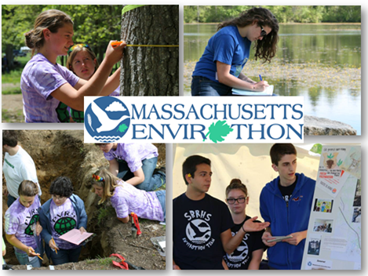
Notes:
The Massachusetts Envirothon is an environmental education program for high school students, emphasizing hands-on, team-oriented problem solving and community involvement that introduces young people to natural resource management and civic engagement.
The Envirothon year culminates in a May competition where teams test their skill and knowledge in forest, soil, wildlife, and water resource management.

Slide 5
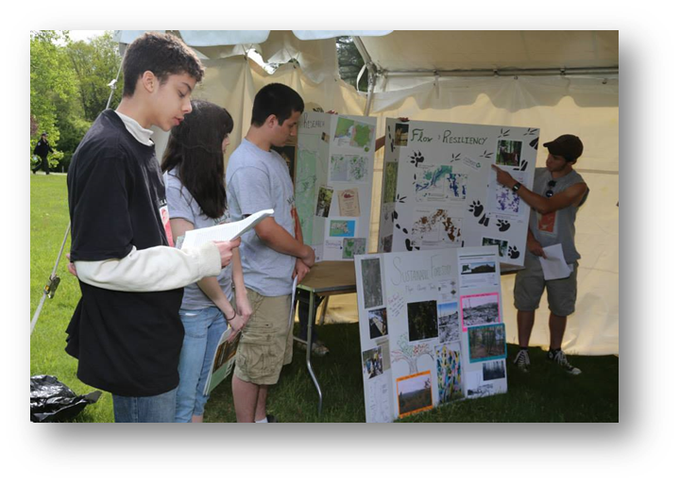
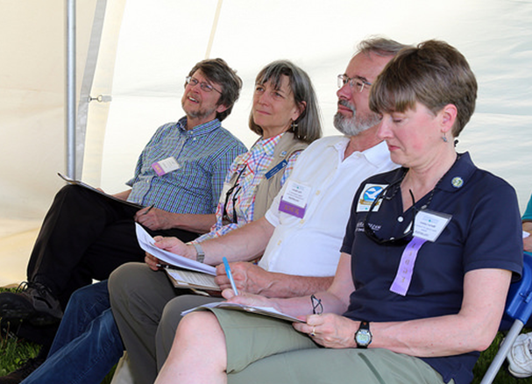
Notes:
In the fifth component of the Envirothon, the Current Issue, teams investigate a critical environmental issue as it occurs in their own community. At the May competition, they make a presentation of their findings and recommendations to a panel of judges. Judges include scientists, resource managers, policy-makers, local officials, and community activists, who give them real world questions and feedback.
The Current Issue emphasis is on thorough, wide-ranging research, including field trips, interviews, library and web searches, and town hall visits. Teams analyze the scientific, management, and policy dimensions of the problems they find, and develop recommendations tailored to the issue as it occurs in their community.
We usually ask them to consider the range of potential actions and then recommend the top priority next step for their community.

Slide 6
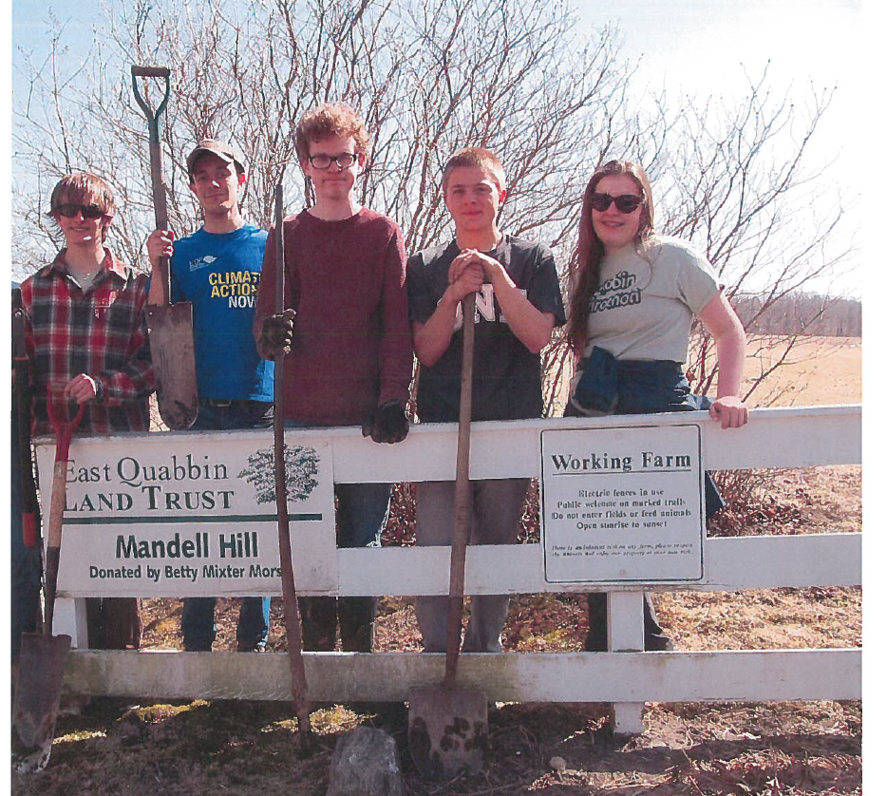
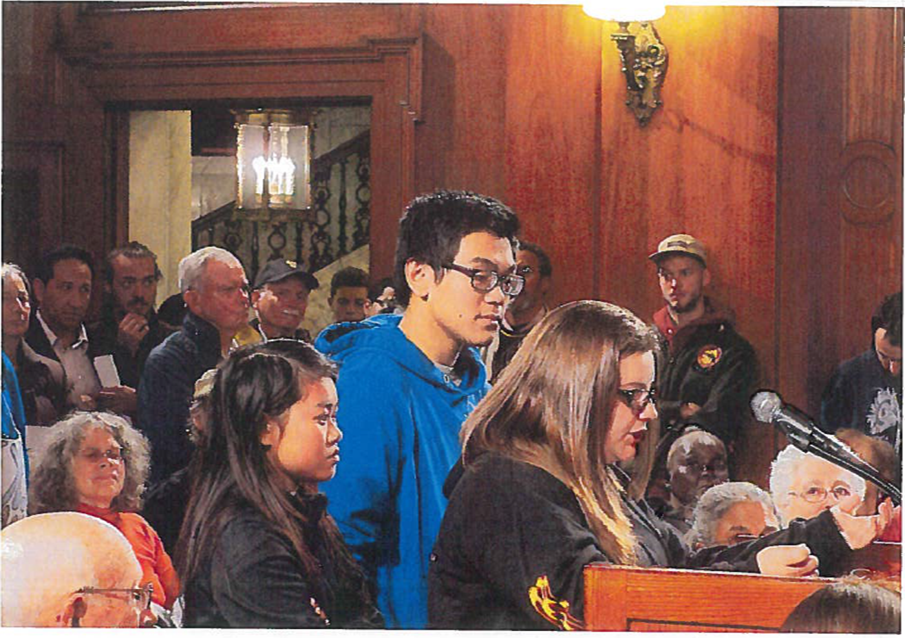
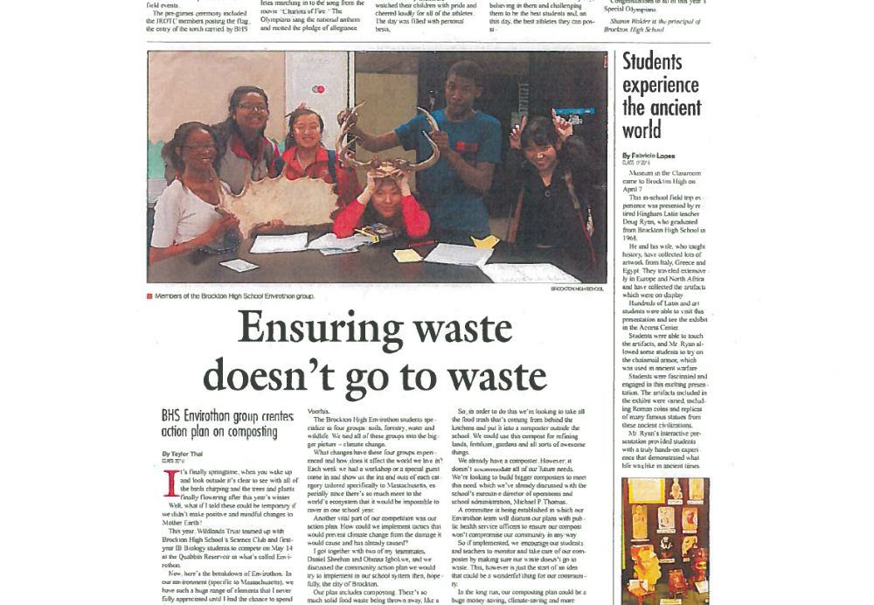
Notes:
The official Envirothon competition concludes with the presentation of their research. However, each year about half the teams take what they have learned in their research and put it to work in a community action project of their choice or design.
In this slide you see the Quabbin team volunteering with the East Quabbin Land Trust, the Brockton team and recognition of their recycling/composting project, and the Springfield Central team testifying in favor of Springfield’s climate action plan.
It is important to note that for these teams, the community action project is a voluntary activity within a voluntary activity. They choose to engage. To me that’s an important indicator of empowerment, and something I think we are looking for in civic engagement projects.
Through their research and the process of developing recommendations for what their communities should do about the issue, teams are engaging in several important elements of the civic engagement process outlined in DESE’s Civics Project Guidebook.

Slide 7
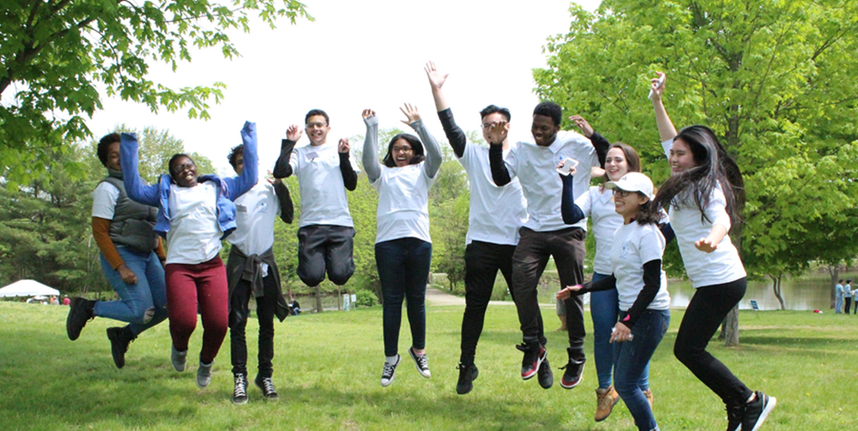
Notes:
Here’s the 2018 Brockton High School team, soon after their presentation took first place in the Current Issue competition.
Since we are talking about community connection here, I’d like to note as an aside that this team is coached by a partnership of a science teacher at the high school and a staff person at a local land trust. We’ve seen this kind of inside/outside partnership be very effective in providing community learning opportunities for youth, and connecting it with school. This is one of the focus areas I wish we had more time to talk about today. I would be happy to talk with you more.
In any case, I love this picture. Envirothon’s community research challenge contributed to the experience you see celebrated here. This is important evidence of success.

Slide 8
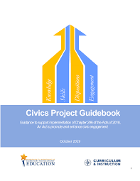
Notes:
As you know, in October 2019, DESE published the Civics Project Guidebook.
The aim was to support the implementation of the 2018 Act to promote and enhance civic engagement (Chapter 296 of the Acts of 2018. The law includes the requirement that
(c) Each public school serving students in the eighth grade and each public high school shall provide not less than 1 student-led, non-partisan civics project for each student; . . .
Civics projects may be individual, small group or class wide, and designed to promote a student’s ability to: (i) analyze complex issues; (ii) consider differing points of view; (iii) reason, make logical arguments and support claims using valid evidence; (iv) engage in civil discourse with those who hold opposing positions; and (v) demonstrate an understanding of the connections between federal, state and local policies, including issues that may impact the student’s school or community.
This is a huge challenge, and it would be a mistake for schools to try to do it alone. It takes a village to raise a child. In particular, it takes a village to teach participation in the village. In our experience there are many community resource people and organizations ready to help.

Slide 9
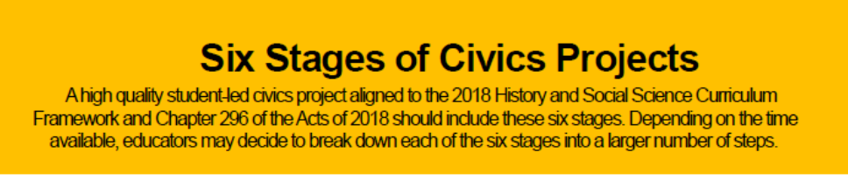
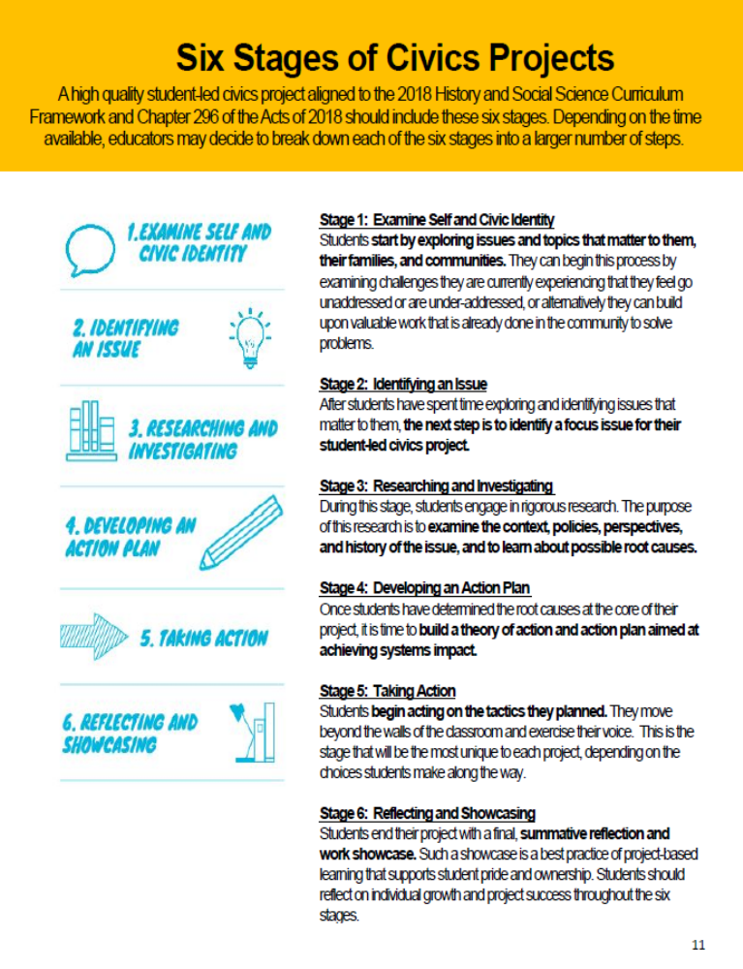
Notes:
The Civics Project Guidebook states that a high quality civic engagement project should include all these 6 stages:
Examining self and civic identity
Identifying an issue
Researching and investigating
Developing an Action Plan
Taking action
Reflecting and showcasing
For Envirothon teams, community research (Stage 3) is the essential core of the experience, but most teams experience most of these stages to some degree as they move through their research and prepare their presentations.
In our experience, all these are not so much stages as they are regions that teams explore as part of engaging in their research. Especially when they are genuinely connecting with the community, teams don’t proceed through the stages in a particular order – and they often circle back. It’s an iterative, sometimes repetitive process.
For this workshop we will focus on how in-depth community research can enhance the learning in each and all of these stages.
CHECK THE CHAT

Slide 10
Stage 3. RESEARCHING AND INVESTIGATING
Exploring human and natural communities
  Encounters with people and organizations
  Field trips to key natural resources and infrastructure
Notes:
The Envirothon encourages first hand research beyond the school walls: We talk about meeting people, exploring places. In particular, we tell teams to get themselves outdoors.
We talk in terms of exploring their “human and natural communities”. This is one of the really big ideas in environmental education:
Our social/civic community relies upon, is embedded within, is inseparable from, and could not exist without its ecological context.

Slide 11
Stage 3. RESEARCHING AND INVESTIGATING
Exploring human and natural communities
  Encounters with people and organizations
    Get the most up-to-date, relevant information from real people
    It will be up to you to ask good questions
    The more you do this, the easier and more fun the research becomes
  Field trips to key natural resources and infrastructure
    Visit people in their native habitat – Lab? Field? Office?
    Whenever possible, visit outdoor places with people who know them well
Notes:
The Envirothon research process begins with learning through conversations with people who are living and working in the natural and human community around them.
We tell teams that a lot of the most important, up to date, relevant information they will find in their current issue research will come from PEOPLE, not books, not the web.
We tell them that when they do research in the community on the current issue, there will be lots of people who are happy to share what they know, but they don’t necessarily have a polished powerpoint presentation or a lecture prepared to explain things. And they are likely to use language that students are not familiar with.
We say: It will be up to YOU to ask the questions that will build your own understanding. There’s always an awkwardness at the beginning when you aren’t even familiar enough with the topic to know the terminology that will allow you to ask good questions. You’ve got to push through that. The more questions you ask, the better you will get at asking them, the more familiar the language becomes, and the easier and more fun the research becomes.
One way to help young people push through this barrier is to have them visit resource people in their native habitat whenever possible – office, lab, water treatment plant, forestry site. There will be show-and-tell opportunities. Youth will see the familiar through different eyes. Questions will come naturally.
Our experience with the Envirothon is this: Empowerment happens as young people talk and visit and become conversant in the issue.
The Brockton team – the team that was jumping for joy – is an example. In their presentation that spring, they all spoke with no notes, and no stilted memorized lines. They seemed completely comfortable with explaining the complexities of Brockton and its water resources.
This was the quick description of their research: The team found that the city of Brockton is in the Taunton River watershed, but draws its drinking water from Silver Lake in the South Coast watershed. Their research focused on the city’s impact on both watersheds: the stress that the city’s water needs has placed on the South Coast watershed, and how the city’s green infrastructure – e.g. wetlands and tree-planting programs – affect stormwater runoff into the Taunton watershed. In their research they made the acquaintance of many resource people on water issues, both in and out of government. They were especially grateful to Brad Holmes of Environmental Consulting and Restoration LLC, and John Condon, Chief Financial Officer of the City of Brockton, who helped them understand the issues thoroughly.

Slide 12
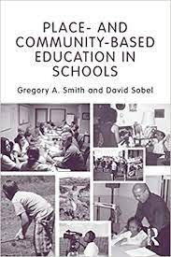
Principles of Place-Based Education
https://promiseofplace.org/what-is-pbe/principles-of-place-based-education
Notes:
This approach to considering the whole human/natural environment has been developed in “place-based” education
Place-based education (PBE) immerses students in local heritage, cultures, landscapes, opportunities and experiences, using these as a foundation for the study of language arts, mathematics, social studies, science and other subjects across the curriculum. PBE emphasizes learning through participation in service projects for the local school and/or community.
See https://promiseofplace.org/what-is-pbe/principles-of-place-based-education
See https://eric.ed.gov/?id=ED515662
Place- and Community-Based Education in Schools
Smith, Gregory A.; Sobel, David
Routledge, Taylor & Francis Group

Slide 13
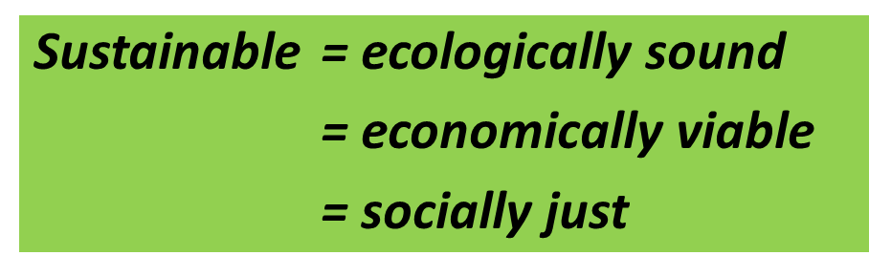
Stage 3. RESEARCHING AND INVESTIGATING
Community environmental research is interdisciplinary
The biggest, most challenging questions of our time require interdisciplinary thinking:
School subjects (especially civics and science) are relevant but don’t define the experience.
Notes:
As you could hear from the description of the Brockton team’s research, Environmental issues are interdisciplinary. The Mass Envirothon Current Issue encourages young people to explore some of the biggest, most challenging issues facing human society: Climate. Energy. Food. Water.
We get our arms around these issues by focusing on what they look like in our own local communities.
We use the definition of Sustainability that has three dimensions. Considering these 3 dimensions requires interdisciplinary thinking: Is it ecologically sound? Is it economically viable? Is it socially just?
Environmental issues inevitably involve both civics and science – a combination we don’t often make in school. However, here is some comforting news. We have found:
The community resource people Envirothon teams interview think and talk in terms of practical understanding of processes and solutions. Many are used to answering questions from members of the public who are definitely not experts.
In my work with the Envirothon Current Issue, I have never found that student teams are confused when connections are made to multiple disciplines. They are focused on explanations and solutions and are happy to draw on expertise wherever they can find it.

Slide 14
Stage 3. RESEARCHING AND INVESTIGATING
Strategies for interdisciplinary exploration:
Spend time outdoors!
Learn by asking questions
Be fearless in the pursuit of understanding
Use maps
Let go of discipline-based curriculum frameworks
Notes:
Mass Envirothon advocates these strategies for Interdisciplinary exploration:
Seek unmediated/uncategorized experiences in your natural and human communities. Get outdoors.
Learn by asking questions. A citizen activist on environmental issues doesn’t have to be a scientist or an engineer. But in order to be an effective activist she needs to be able to ask good questions of scientists and engineers. Understanding some basic concepts and terminology around physical, chemical, and biological processes in everyday life is very useful. Understanding this can be a motivator – there ARE real reasons to be familiar with what’s in that textbook!
The most important quality in community research is fearless pursuit of understanding. Think about Erin Brockovich.
In order to be able to ask good questions, become familiar with the language and mindset and values and perspectives of those immersed in the issue.
Use maps!
Geography focuses broadly on the relationship of people to the land. In many ways it is an “interdisciplinary discipline”.
Maps are especially useful tools, as they integrate knowledge from multiple disciplines. Information is presented graphically, disarming our usual text-based disciplinary defenses. You can also start exploring from anywhere on a map.
Google Earth can be a fun place to start, especially if your issue involves land use or water resources. Fly over your community at https://www.google.com/earth/
Mass GIS maintains the Oliver online data viewer that allows you to build maps for all kinds of purposes, not just environmental. https://www.mass.gov/service-details/oliver-the-massgis-online-data-viewer
Your town may have good GIS maps as well.
One helpful exercise is to let go of discipline-based curriculum frameworks. At least, loosen your grip enough to pull away and get a different perspective.

Slide 15
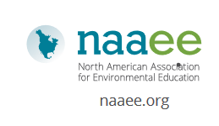
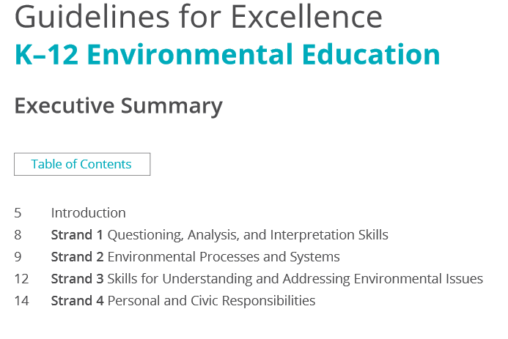
Notes:
Here is a great alternative curriculum framework to give you a different perspective. I use it every year to check to see whether I’m covering all the bases as I develop the Current Issue:
About 20 years ago the North American Association for Environmental Education undertook a project to define and set standards in the field of Environmental Education. This was a consensus project developed with input from hundreds of educators at all grade levels from across North America
Among other things, the resulting document seamlessly integrates science and civics.
You will also find it very compatible with development of civic engagement projects. Environmental education has always been about moving “from awareness to action”. “Environmental Literacy” includes engagement in making the world a better place
Guidelines for Excellence: Best Practice in EE
https://naaee.org/our-work/programs/guidelines-excellence

Slide 16
Notes:
CHECK THE CHAT for questions related to research
At this point, we could dive into any of these other stages and look at how an emphasis on community research can contribute to it.
We thought that one should certainly be stage 1: Examining self and civic identity

Slide 17
Stage 1. EXAMINING SELF & CIVIC IDENTITY
Examining self and civic identity can happen naturally as part of community research
The concept of community is particularly rich in the context of environmental issues
Notes:
We find that the work of examining self and civic identity can happen naturally and meaningfully as part of the community research process. The young people on Envirothon teams are asking:
How is this issue important to me? How does it affect me? What questions do I have? How does it affect my family, my school, my community? The fact that each team takes a journey influenced by its members, its school, its location, its interests, its priorities, etc...IS centering the work around identity.
The concept of community is particularly rich in the context of environmental issues. Again, we emphasize the idea that our human community is embedded in the larger ecological community.

Slide 18
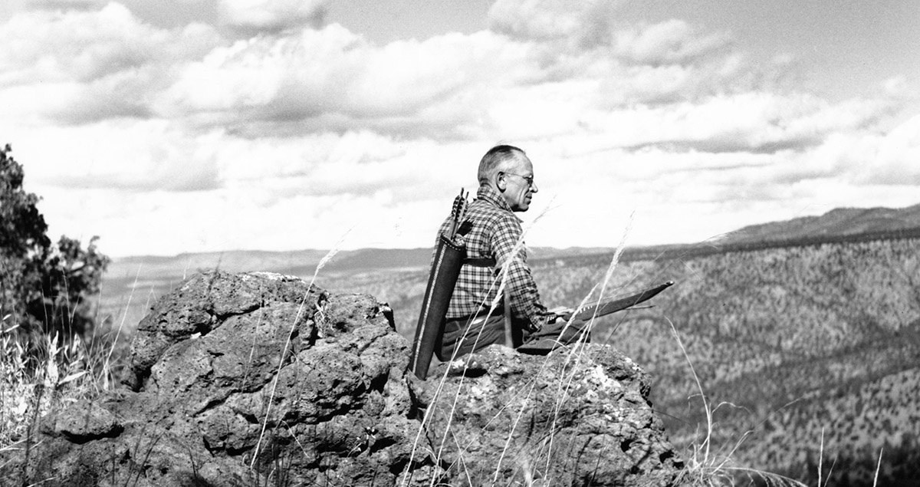
Stage 1. EXAMINING SELF & CIVIC IDENTITY
The land ethic simply enlarges the boundaries of the community to include soils, waters, plants, and animals, or collectively: the land.
A land ethic changes the role of Homo sapiens from conqueror of the land-community to plain member and citizen of it. It implies respect for his fellow-members, and also respect for the community as such.
- Aldo Leopold “The Land Ethic” 1948
Notes:
Here is Aldo Leopold, one of the parents of the modern environmental movement, on what he called the land ethic:
The land ethic simply enlarges the boundaries of the community to include soils, waters, plants, and animals, or collectively: the land.
A land ethic changes the role of Homo sapiens from conqueror of the land-community to plain member and citizen of it. It implies respect for his fellow-members, and also respect for the community as such.
- Aldo Leopold “The Land Ethic” 1948
As part of getting to know this larger community:
We promote the idea that we are members of both human and ecological communities, human systems embedded in ecological systems
We encourage young people to spend time outdoors, exploring built as well as natural surroundings. “The environment is where we live” is a powerful statement.
We encourage young people to get to know their communities through the eyes and hearts of real people who live there.
For example, we encourage exploration of the history of people and the land: Interview a long time resident about the issue and changes they have seen in their lifetimes.
We say: Fall in love with the sights, sounds, feel, smell of your local environment. Be curious and engage critically with it as well. We protect what we love.

Slide 19
Stage 1. EXAMINING SELF & CIVIC IDENTITY
Examining self and civic identity happens naturally as part of community research
The concept of community is particularly rich in the context of environmental issues
The concept of a Theory of Change might be useful in community research interviews
Notes:
Here is a curve ball for those of you following the Six Stages of Civic Engagement in order:
The concept of a Theory of Change (or Theory of Action) might be very useful in community research interviews.
The idea of a theory of change is included as part of Stage 4 of civics projects: Action planning. But it may be a very useful concept for a community research toolkit.
Theory of Change (or Theory of Action) was a new term to me when I read the Civics Project Guidebook. I was intrigued.
What do we mean by a Theory of Change?
Wikipedia defines it as: a method for planning, participation, and evaluation used in companies, philanthropy, nonprofits, and government sectors to promote social change. A Theory of Change defines long-term goals and then maps backward to identify necessary preconditions.
In other words, a Theory of Change makes explicit our assumptions about the connection between objectives and the tactics we choose.
Laying out your Theory of Change is like making a roadmap that outlines the steps by which you plan to achieve your goal. It helps you assess whether your work is contributing towards achieving the impact you envision, and if there is another way that you need to consider as well.
The Guidebook places some emphasis on students developing their own Theory of Change as the basis for an action plan.
I believe it also may be a useful lens for their interviews with community resource people:

Slide 20
Stage 1. EXAMINING SELF & CIVIC IDENTITY
Theory of Action – a useful lens for community interviews?
How change happens in this community
What are the leverage points
How they choose to engage
What they count as success
How their experience and temperament affects their theory
Notes:
We all have theories of action underlying our choices for what we do. Usually they are unstated and unexamined.
It might be very enlightening to listen to what community people say about
How change happens
What are the leverage points to effect change
How they choose to engage
What they count as success
How are their choices of strategy affected by their knowledge, skills, and temperament; their experiences and connections?
There are a variety of potential action strategies to address any environmental issue – some are more effective or comprehensive than others. Which one(s) should we choose?
Ultimately, paying attention to the theories of action held by the community resource people they interview will broaden and sharpen students’ understanding of the choices of strategy they can make.
Your Theory of Action is an element of your civic identity: What action strategies will be most effective for who you are?

Slide 21
Notes:
The Civics Project Guidebook places a lot of emphasis on Stage 2. Identifying an issue. The goal is participant ownership of the issue, arousing students’ intrinsic motivation.
The process of choosing an issue can not only foster student leadership but also to promote a democratic team approach to the project. Building consensus around a single community issue is seen as key.
The Envirothon takes a different approach. The program very clearly designates the current issue every year, but it does so in a way that still promotes participant ownership and student leadership, in ways that offer other benefits as well.
Examining self and civic identity
Identifying an issue
Researching and investigating
Developing an Action Plan
Taking action
Reflecting and showcasing

Slide 22
Stage 2. IDENTIFYING AN ISSUE
Goal: participant ownership, student-led projects, empowerment
Notes:
The Act to Promote and Enhance Civic Engagement is very clear that civic engagement projects must be “student-led”. Empowerment of young members of the community to participate is a goal we all aspire to.
This is a big, important topic worthy of more attention than this presentation can give it. We all have different experiences and definitions and criteria for what “student-led” looks like. I have interviewed Envirothon teams and coaches and been impressed by the variety of forms that student leadership and participant ownership can take, and ways to encourage it. All these forms can contribute to the development of effective adult participation.
Here I want to describe how the Envirothon process works. Yes, Envirothon identifies and frames the issue in general terms before the teams get it. Recent Current Issues have included:
Sustainable Local Agriculture
Managing Invasive Species
Water Resources and Climate Change
But Envirothon still leaves much room for team choice.

Slide 23
Stage 2. IDENTIFYING AN ISSUE
Goal: participant ownership, “student-led projects”, empowerment
What does this issue look like in YOUR community?
  What unique combinations of landscape, people, history, and infrastructure do you find?.
  What matters to you? To others in your community?
Notes:
We ask: What does the issue look like in YOUR community?
The issue takes a different form, and offers multiple, diverse research opportunities, in each Massachusetts community
Each community has unique combinations of people with unique personalities and expertise, unique history, unique infrastructure, their own unique landscapes
Each team chooses its own angle on the issue, and its own research path, based on what matters to them and their community and what they find along the way.
The issue takes a different form, and offers multiple research opportunities, in each Massachusetts community.

Slide 24
Stage 2. IDENTIFYING AN ISSUE
Goal: participant ownership, “student-led projects”
What does the issue look like in your community?
  Articulating the issue as an ongoing element of community research
Notes:
Ongoing articulation of the focus issue is a central element of an Envirothon team’s community research experience.
Identifying, defining, and refining the local issue is part of the teams’ research process all the way through to presentation. Each interview or site visit can add perspective, dimension, new language to the issue definition

Slide 25
Stage 2. IDENTIFYING AN ISSUE
Goal: participant ownership, “student-led projects”
What does the issue look like in your community?
  Articulating the issue as an ongoing element of community research
Framing the issue for critical engagement
Notes:
A key value of framing the general issue for Envirothon teams is the opportunity to set the stage for more critical engagement by the teams.

Slide 26
Stage 2. IDENTIFYING AN ISSUE
Goal: participant ownership, “student-led projects”
What does the issue look like in your community?
  Articulating the issue as an ongoing element of community research
Framing the issue for critical engagement
  Messaging vs. Education
Notes:
Messaging vs. Education. We have found that government agencies addressing environmental issues have their own working definitions of the problem. Their public messaging is aimed primarily at behavior modification: they want to influence the public to adopt particular habits and take particular actions. The focus is on creating appealing presentations and uncomplicated content and concepts, to spur behavioral change. They worry – with justification – about attention spans and issue complexity.
This is different from our role as educators. Our job is to introduce more juiciness and complexity, to reframe, to spur critical thinking, particularly through calling attention to different, sometimes dissident perspectives.
Is our goal well-behaved citizens or critically thinking citizens? Usually there is no conflict, but still, it’s an issue that we need to keep an eye out for as we introduce young people to real live issues.

Slide 27
Stage 2. IDENTIFYING AN ISSUE
Goal: participant ownership, “student-led projects”
What does the issue look like in your community?
  Articulating the issue as an ongoing element of community research
Framing the issue for critical engagement
  Messaging vs. Education
  Attention to alternative or dissident perspectives: climate, energy, justice
  Examples of Alternative Framing:
    Nonpoint source pollution becomes stormwater management
    Native and invasive species in a changing world
    Water supply as an energy issue
Notes:
In the interest of critical analysis of issues, Envirothon asks teams to consider: how will climate change affect this issue over the next 30 years? How is energy use a factor? Are the solutions worth the cost given other societal priorities? How do different neighborhoods and groups in our community experience the issue differently? What new technologies and techniques are coming on the scene that could change the issue and how we respond?
Examples:
Nonpoint source pollution becomes stormwater management
Native and invasive species in a changing world
Water supply as an energy issue

Slide 28
Notes:
Stage 4 of Civics Projects focuses on developing an action plan.
Developing an action plan, and taking action, are the key experience for a civic engagement project. They are NOT an Envirothon requirement for teams participating in the competition.
As part of their presentation to judges, Envirothon teams make a recommendation for next steps that their community should take to address the issue, including consideration of cost and who should be involved. But officially, Envirothon stops with this report on their research and recommendations.
Examining self and civic identity
Identifying an issue
Researching and investigating
Developing an Action Plan
Taking action
Reflecting and showcasing

Slide 29
Stage 4. DEVELOPING AN ACTION PLAN
Whether or not to take action
  An authentic decision
  Is system change necessary? Service or civic engagement?
Notes:
Nevertheless, we have found that at least half the teams every year engage with the community in some way beyond their research and recommendations. Their research experience usually has a lot to do with their decision to take action.
Their decision to engage is authentic – just as it is for adult citizens. It’s not an assignment. So their questions include: What action is needed to address this problem? Who is already involved? How might we engage? Will our participation make a difference? Do we have time? Will it be fun?
When they do decide to engage, it’s a voluntary activity within a voluntary activity. This is worthy of note: if internal motivation is the gold standard, as it should be in learning to engage in community issues, then this is a good approach.
On some issues in some communities, teams find that “system change” is not necessary, but there is still work to be done.
The Civics Project Guidebook highlights the distinction between civics projects and service projects. Civics projects are different because they seek to identify root causes and to work for system change.
While we encourage Envirothon teams in this direction, all forms of community engagement are welcomed.

Slide 30
Stage 4. DEVELOPING AN ACTION PLAN
Whether or not to take action
  An authentic decision
  Is system change necessary? Service or civic engagement?
Plug into an existing effort? Design your own project?
Notes:
For their action projects, most Envirothon teams connect with an ongoing effort in the community. They choose to work with and learn more from an organization or person they have come to admire through their research process.
Some Envirothon teams develop their own action project. In these cases, their consensus on a project grows out of a compelling idea or opportunity they encounter in their research. When they develop their own idea, it is most often a public education project – perhaps adults, perhaps elementary students.
We have found that there is a qualitative difference in the experience of a service project when the group has a deep understanding of the issues, places, and people – and why the work is important. That understanding comes from their research.

Slide 31
Stage 4. DEVELOPING AN ACTION PLAN
Community Research
Community Connection
Taking Action
Notes:
A major value of a heavy emphasis on community research is the opportunity for making and sustaining connections with community resource people and organizations out of which action projects can grow.
Teachers can’t be experts on every issue topic. The community connections can help.
Encounters with people in the community can not only provide important research information, but also introduce young people to role models and potential routes in education and careers.
Individual educators can cultivate ongoing positive relationships with their community beyond the projects that can have multiple benefits for the school, teacher, and students – over multiple years

Slide 32
Stage 4. DEVELOPING AN ACTION PLAN
Apprenticeship – the most powerful form of learning?
We learn through legitimate peripheral participation in a community of practice
  (Jean Lave & Etienne Winger, Situated Learning, 1991)
Conservation and environmental protection are an active, vibrant community of practice in Massachusetts
Community research is an opportunity for legitimate peripheral participation
Notes:
Social anthropologists who have studied human learning have theorized that we learn by legitimate, peripheral participation in a community of practice.
A community of practice is a group of individuals participating in communal activity, continuously experiencing and creating their shared identity through engaging in the practices of their communities. When newcomers join an established group or community, they spend some time initially observing and perhaps performing simple tasks in basic roles as they learn how the group works and how they can participate. (Wikipedia)
Essentially, we learn by apprenticeship.
In Envirothon’s experience, conservation and environmental protection are an active, vibrant community of practice in Massachusetts, and community research is an opportunity for legitimate peripheral participation.
Action projects that grow out of research connections with community organizations are a form of apprenticeship – one of the most powerful, durable, effective forms of human learning. The role of the Envirothon coach is to facilitate something close to the apprenticeship experience: encounters with thoughtful, experienced environmental activists, scientists, local officials, natural resource managers.
This may mean that when young people develop their own action plans from scratch rather than plugging into ongoing community projects, they can miss some important learning opportunities.
Plugging into ongoing community work as part of a community service project gets a bad name when students aren’t invested in the work. A major value of the Envirothon’s focus on research is that the teams tend to be knowledgeable about the people, places, and theories of change involved in the work. They are invested in success, not just concerned with putting in their hours.
From the perspective of community projects as an apprenticeship experience, it makes sense for teams to plug in to activities they have identified as making a difference, and have a chance to observe and practice under the guidance of long term activists
From a practical standpoint, community organizations are more likely to welcome the involvement of young people if their projects further, or at least dovetail, with identified community agendas. At the very least, students should be able to explain how their project intersects or reinforces existing work.
From both perspectives, an emphasis on community research is important.

Slide 33
Notes:
In terms of actually taking action in stage 5:
Examining self and civic identity
Identifying an issue
Researching and investigating
Developing an Action Plan
Taking action
Reflecting and showcasing

Slide 34
Stage 5. TAKING ACTION
Benefits of joining an ongoing community environmental project
Closer contact with committed community people
  Individual adults
  The environmental “community of practice”
  A form of apprenticeship learning
Contribute to an ongoing project with lasting impact
Earn community gratitude
Achieve a sense of pride and ownership
Teacher/advisor doesn’t have to be an expert, can focus on facilitating learning
Potential for continued school/community partnership
Notes:
We see a lot of practical and educational benefits in joining an ongoing community project rather than striking out on your own.
A major value of an emphasis on community research is the opportunity for making and sustaining connections with community resource people and organizations.
Teachers can’t be experts on every issue topic. If learning the science and engineering involved in an issue is important, for example, the community connections can help.
The encounters can not only provide important research information, but also introduce young people to role models and potential routes in education and careers.
Individual educators can cultivate ongoing positive relationships with their community beyond the projects that can have multiple benefits for the school, teacher, and students – over multiple years
Action projects that grow out of research connections with community organizations are a form of apprenticeship, so teams are participating in one of the most powerful, durable, effective forms of human learning.
In addition, teams
Contribute to an ongoing project with lasting impact – a project in which at least a segment of the environmental community has decided to put their energy for the longer run
Earn community gratitude – for themselves and their schools
Achieve a sense of pride and ownership
Further, their teacher/advisor
doesn’t have to be an expert, can focus time and effort on facilitating the experience
Can cultivate continued school/community partnership

Slide 35
Stage 5. TAKING ACTION
Downsides of joining an ongoing community environmental project
Close work with community people working on the issue can reinforce unhelpful societal norms and race/class/political stereotypes
Less potential for decision-making and agency
Less opportunity for alternative issue framing
Notes:
The downsides of joining an ongoing community project are essentially the downsides of the apprenticeship form of learning:
Close work with community people working on the issue can reinforce unhelpful societal norms and race/class/political stereotypes
There may be less potential for decision-making and agency, although this might be just what the young people need.
The groups we partner with may be justifiably focused narrowly in order to get to their next objectives. In these cases, it is up to the teacher/coach/advisor to help young people see the big picture or an alternative issue frame.

Slide 36
Notes:
Stage 6, Reflecting and Showcasing, is critical to the Envirothon learning experience
Examining self and civic identity
Identifying an issue
Researching and investigating
Developing an Action Plan
Taking action
Reflecting and showcasing

Slide 37
Notes:
The Current Issue emphasis is on thorough, wide-ranging research, including field trips, interviews, library and web searches, and town hall visits. Teams analyze the scientific, management, and policy dimensions of the problems they find, and develop recommendations tailored to the issue as it occurs in their community. They make a presentation to a panel of judges including scientists, resource managers, policy-makers, local officials, and community activists, who give them real world questions and feedback.

Slide 38
Stage 6. REFLECTING AND SHOWCASING
Envirothon Current Issue Presentations and Roundtables
Reflection is ongoing throughout the project
Value of competitive showcasing?
Formal presentation to the environmental community
Informal presentation to peers
Notes:
Reflection is ongoing throughout the project: New research information and community experiences spur new reflection.
Is organizing the showcase as a judged competition helpful if our goal is to promote civic action for the sake of community improvement? We have found that competition provides a motivation boost for many teams, but it can detract from the sense that we are all in this together.
The teams’ formal presentations to judges are a dramatic demonstration of “legitimate peripheral participation in a community of practice”
Outside the framework of the competition, Envirothon teams are invited, at lunchtime after the competition, to participate in a Roundtables session, where teams can talk informally, learn what the issue looks like in other Massachusetts communities, and how other teams pursued their research process. For the Envirothon, one benefit of a designated issue with local differences is that when teams meet at the May competition they have some common understanding that can serve as a basis for more in-depth conversation at the roundtables.

Slide 39
Summary Points
An emphasis on community research can lead to deeper, more meaningful community engagement
In your approach to interdisciplinary environmental issues
  Be fearless and persistent in questioning
  Remember that disciplinary boundaries don’t mean much either to students or community activists
There are civics education benefits for to joining an ongoing community project, if the decision is voluntary and based on in-depth research
In terms of gaining knowledge, skills, and attitudes for civic engagement we need to pay special attention to
  What “student-led” means in practice, every step of the way
  How decisions, particularly about action, are made
Notes:
Summary points
An emphasis on community research can lead to deeper, more meaningful community engagement
In your approach to interdisciplinary environmental issues
Be fearless and persistent in questioning
Remember that disciplinary boundaries don’t mean much either to students or community activists
There are civics education benefits for to joining an ongoing community project, if the decision is voluntary and based on in-depth research
In terms of gaining knowledge, skills, and attitudes for civic engagement we need to pay special attention to
What “student-led” means in practice, every step of the way
How decisions, particularly about action, are made

Slide 40
More Community Research Reality Checks
(from Envirothon experience)
Authentic, community-connected research rarely syncs well with the school calendar
Opportunities for connection tend to come at inconvenient times
It is possible to start the research with any place or person. There will always be a need to circle back
Reflection is ongoing and necessary in all stages – this is related to the student-led quality of the experience

Slide 41
Selected Resources
Massachusetts Envirothon Current Issue
Issue introduction and Guide to Community Research
Current Issue Problem
Place- and Community-based Education in Schools
Gregory A. Smith and David Sobel
Guidelines for Excellence: K12 Environmental Education
North American Association for Environmental Education

Slide 42

Will Snyder wsnyder@umass.edu
UMass Extension/4-H
Stacey Hill shill@worcesterschools.net
Doherty Memorial High School, Worcester

